Slide 1










AWS Billing and Cost Management
Track, analyze, and control your AWS spending
Billing Dashboard
Cost Explorer
Budget & Alerts
Monitor your spending with detailed insights and visualizations
Analyze usage patterns and identify cost optimization opportunities
Set up custom budgets and receive notifications when thresholds are reached
AWS

Slide 2

















Billing Dashboard Walk-through
A centralized view of your AWS spending
What is the Billing Dashboard?
Cost Summary
Cost Monitor
Month-to-date
Forecast
Budget overrun detected
The AWS Billing Dashboard provides a high-level summary of your AWS spending, offering immediate insights into your financial posture.
Last month
Current period
Alerts to budget overruns
Key Benefits
Quick visibility into current spending
Forecasting of future costs
Cost Breakdown
Recommended Actions
Customizable widgets for specific needs
Service A
Service B
Optimize resources
Review unused services
Visual cost categories
AWS

Slide 3
















Cost Explorer & Usage Reports
Tools for detailed cost analysis
AWS Cost Explorer
AWS Cost & Usage Reports (CUR)
Visualize and analyze AWS costs through interactive graphs.
Detailed billing data for deep analysis.
Key Features
Key Features
Visualize costs
Detailed CSV reports
Filter by service or account
Automated S3 delivery
Best Use Cases
Cost Explorer
Cost & Usage Reports
Cost analysts needing detailed spend analysis
Deep accounting and auditing

Slide 4













Set Up Cost Budget & Alerts
Track costs and receive notifications when spending approaches defined thresholds
Creating an AWS Budget
Configuring Alerts
AWS Budgets enable proactive financial governance by tracking costs and sending alerts when thresholds are approached.
Alert Thresholds
1Open AWS Billing Console
Percentage
Absolute Amount
Navigate to Billing & Cost Management
80%
$1,000
2Choose "Create Budget"
Notification Recipients
Select "Customize (advanced)" setup
3Configure Budget Settings
Set budget name and period
Email
SNS Topics
AWS Chatbot
Define budget amount
Up to 10 recipients
Integration options
Team communication

Slide 5

















Stay Connected with Our Cloud Computing Journey!
Dive deeper into the cloud world! Check out our specialized playlists for your continuous learning journey!
Like this video if you found it helpful!
Subscribe for cloud tech updates!
Comment below which cloud topic you want to see next like:
Cloud Security Tips
Cost Optimization Strategies
Multi-Cloud Management
Serverless Computing
Cloud Migration Steps
Anything you'd like 🙂

Slide 6





AWS Service Quotas
Managing Resource Limits in the Cloud
Control Your AWS Resources
© 2025 AWS, Inc. or its affiliates.

Slide 7










Introduction to AWS Service Quotas
What are AWS Service Quotas?
AWS Service Quotas define the maximum values for resources, actions, and items that an AWS account can provision or utilize for each AWS service. They safeguard both the AWS infrastructure and its users from unintentional over-provisioning, excessive billing, or service degradation.
Safeguard Mechanism
Resource Guardrails
Protects against accidental overspending and ensures fair resource distribution across users in the cloud environment.
Act as essential guardrails to prevent service degradation that could result from resource overutilization.
Operational Stability
Adjustable Limits
Ensures system stability and prevents unintended over-provisioning that could affect performance.
Most quotas can be increased upon request, allowing users to scale their resource limits as needed.
AWS Service Quotas
2/10

Slide 8












Core Concepts
Quota Types
Quota Levels
Region-Specific vs. Global
Account-Level
Region-specific quotas are tied to specific AWS Regions
Quotas that apply to the entire AWS account for a given service.
Global quotas apply across all Regions (increasable from US East only)
Total number of EC2 instances allowed within an account
Adjustable vs. Non-Adjustable
Adjustable quotas can be modified upon request
Resource-Level
Non-adjustable quotas are fixed maximums set by AWS
Quotas specific to individual resources within a service.
Number of instances per Amazon OpenSearch Service domain
AWS Service Quotas
3/10

Slide 9
















Viewing and Monitoring Quotas
Centralized Visibility
Proactive Management
Access current quotas and resource utilization through the AWS Management Console. View default AWS quota values and account-specific applied quotas.
Receive notifications when resource consumption approaches quota limits. Set alarms at specific percentages (e.g., 80%) to ensure timely intervention.
CloudWatch Integration
Capacity Planning
Monitor your current resource usage against defined quotas. Set up alarms to notify when consumption approaches a specified percentage of a quota.
Use monitoring data to identify trends and plan for future resource needs. Scale capacity before hitting bottlenecks that could impact performance.
Quota Monitoring Workflow
Resource Usage
CloudWatch
Threshold Alert
Notification
AWS Service Quotas
4/10

Slide 10










Requesting Quota Increases
AWS Management Console
AWS CLI/SDK
AWS Support Case
Use command: request-service-quota-increase
For services not integrated with Service Quotas console
Navigate to the Service Quotas console
Specify service and quota codes
For urgent requests
Select the relevant AWS service
Requires appropriate IAM permissions
For previously denied requests
Choose the specific quota
Open direct AWS Support case
Click "Request increase" and specify higher value
Command returns request ID for tracking
Approval Process Notes
Smaller requests might be automatically approved
Approved increases are not immediate (can take days)
Approval not guaranteed (may be partial or denied)
Plan ahead as approval processes can take time
AWS Service Quotas
5/10

Slide 11









Multi-Account Management
AWS Service Quotas integrates with AWS Organizations to create quota request templates, automating consistent quota increases across multiple accounts within an organization.
Management Account
Creates quota templates
Organizational Unit
Child Account 1
Child Account 2
Child Account 3
Applies templates
Auto-configured
Auto-configured
Auto-configured
Standardized Governance
Reduced Overhead
Ensures all accounts adhere to organizational policies and operational requirements.
Automates quota increase requests for new accounts, significantly reducing manual effort.
AWS Service Quotas
6/10

Slide 12













Key Benefits
AWS Service Quotas offer significant advantages for managing cloud resources effectively, contributing to operational stability, cost efficiency, and streamlined governance.
Enhanced Operational Reliability
Improved Cost Control
Simplified Resource Planning
Serves as a critical safeguard against uncontrolled spending by limiting the maximum number of resources that can be provisioned.
Prevents unexpected service disruptions by establishing and monitoring resource limits, ensuring capacity is scaled before it becomes a bottleneck.
Centralized visibility into current and applied quotas across all AWS services and Regions simplifies capacity planning and scaling.
Consistent Multi-Account Governance
Reduced Administrative Overhead
Better Visibility and Transparency
Integration with AWS Organizations enables standardized quota configurations across an entire enterprise, ensuring all accounts adhere to organizational policies.
The Service Quotas console provides a single pane of glass for viewing all service quotas, their adjustability, and current usage.
Automating quota increase requests and monitoring significantly reduces the manual effort required from cloud administrators.
AWS Service Quotas
7/10

Slide 13











Best Practices
Maximize the effectiveness of AWS Service Quotas with these best practices:
Proactively Monitor Usage
Request Increases Before Hitting Limits
Use Amazon CloudWatch to monitor resource utilization against quotas. Set up alarms for timely intervention.
Plan ahead based on projected growth and request increases in advance, as approval processes can take time.
Understand Quota Types
Leverage Automation
Identify adjustable vs. non-adjustable quotas to design your architecture appropriately.
Use AWS Organizations integration to create quota request templates for standardized governance.
Regularly Review Quotas
Document Quota Changes
Periodically review service quotas and actual usage to ensure they align with operational needs.
Maintain records of quota increase requests for auditing and future capacity planning.
AWS Service Quotas
8/10

Slide 14





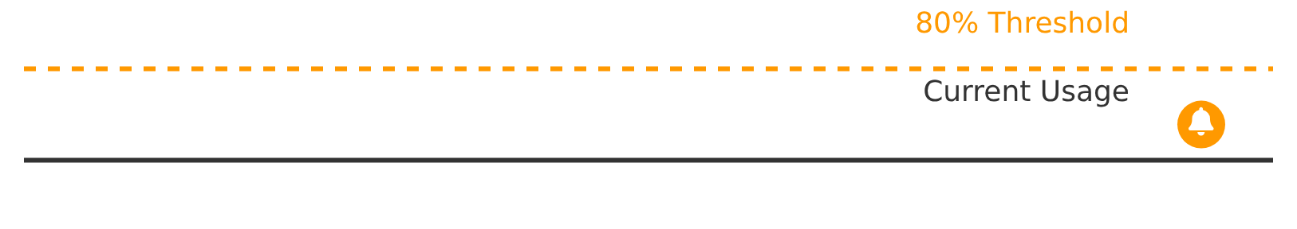







Integration with CloudWatch
CloudWatch Integration
AWS Service Quotas integrates with Amazon CloudWatch, allowing you to monitor your current resource usage against defined quotas. This integration enables you to set up alarms that notify you when resource consumption approaches a specified percentage of a quota, helping you request increases before reaching hard limits.
CloudWatch Metrics
Alarm Setup
Proactive Alerts
Usage Trends
Disruption Prevention
Receive notifications when usage approaches defined thresholds, allowing for timely action.
Visualize historical usage patterns to forecast future resource needs and plan quota increases.
Set alarms at 80% utilization to ensure increases are requested before reaching hard limits.
AWS Service Quotas + CloudWatch
9/10

Slide 15





Understanding AWS Pricing Models
On-Demand, Reserved Instances, Spot Instances & Savings Plans
On-Demand
Reserved
Spot
Savings Plans

Slide 16















On-Demand Instances
Key Characteristics
Ideal Use Cases
No Long-Term Commitment
Unpredictable Workloads
Development & Testing
Pay-as-you-go approach with no contracts or planning required
Variable demand patterns
Ephemeral environments
Per-Second Billing
Billed per second for Linux, Windows, and Windows with SQL (min 60 seconds)
New Applications
Short-Term Needs
Unknown usage patterns
Sporadic computing requirements
Highest Cost, Maximum Flexibility
Most expensive but offers unparalleled flexibility for fluctuating workloads
Pay-as-you-go: No minimum terms
Flexible: Start/stop as needed

Slide 17














Reserved Instances (RIs)
Overview
Payment Options
Payment Option
Term Lengths
Discount Level
Commit to specific instance configuration for 1-3 years
Get up to 72% discount vs On-Demand
No Upfront
1 or 3 years
Up to 37% (1-year), up to 57% (3-year)
Standard RIs
Convertible RIs
Partial Upfront
1 or 3 years
Up to 40% (1-year), up to 60% (3-year)
Significant discounts
More flexibility
All Upfront
1 or 3 years
Up to 41% (1-year), up to 62% (3-year)
Change AZ, instance size
Change instance family
Flexible networking
Change OS or tenancy
Ideal Use Cases
Steady, predictable workloads
Consistent computing needs
Capacity reservation required
Predictable monthly costs
Up to 72% discount vs On-Demand
Best for steady workloads

Slide 18











Spot Instances
Key Characteristics
Ideal Use Cases
Deep Discounts
Stateless Applications
Upt to 90% off On-Demand prices
Containerized Workloads
Can restart without data loss
Microservices architecture
Pricing Model
Based on supply and demand trends
CI/CD Pipelines
Batch Processing
Interruption Risk
Build and test environments
Scheduled tasks
Two-minute notice if capacity needed
Pay: Upt to 90% less
Risk: 2-min interruption

Slide 19








Savings Plans Explained
Overview
Flexible pricing model offering discounts on AWS usage in exchange for a commitment to consistent compute usage ($/hour) over a 1-year or 3-year term.
Compute Savings Plans
EC2 Instance Savings Plans
Up to 66% savings
Up to 72% savings
Highest flexibility - applies to any EC2 instance
Deepest discounts for EC2 instances
Covers EC2, Fargate, and Lambda usage
Commitment to specific instance family
Change instance types, regions, or services
Change between instances in committed family
Key Benefits
1 or 3-year term commitment
Consistent $/hour pricing
Flexible usage across services
Note: - Savings Plans provide pricing discounts only and do not include capacity reservation

Slide 20

















Pricing Model Comparison
On-Demand
Reserved
Spot
Savings Plans
Cost Savings
0%
Up to 72%
Up to 90%
Up to 72%
Commitment
None
1-3 years
None
1-3 years
Flexibility
Max
Med
Low
High
Payment Model
Pay-as-you-go
All/Prt/No
Variable
Hourly
Best Use Case
Unpredictable
Steady-state
Fault-tolerant
Consistent
Selection Guidance:
Choose based on your workload characteristics. Use Spot for fault-tolerant workloads, Reserved for steady-state, On-Demand for unpredictable needs, and Savings Plans for consistent usage across services.

Slide 21















Question 10: Spot Instances
Which EC2 purchasing option offers the largest discount but comes with the risk of interruption?
Up to 90% off
Two-minute warning
A
On-Demand Instances
B
Reserved Instances
C
Spot Instances
D
Dedicated Instances

Slide 22




Answer 10: Spot Instances
C.
Spot Instances
Correct Answer
Explanation:
Discount Potential
Up to 90%
Spot Instances offer the largest discount (up to 90%) compared to On-Demand prices.
On-Demand Price
Spot Price
However, they can be interrupted by AWS with a two-minute notification if capacity is needed elsewhere.
Interruption Notice
2 min
They are suitable for fault-tolerant, flexible workloads that can handle interruptions.
AWS will notify you with a two-minute warning before reclaiming capacity.

Slide 23








Question 11: Reserved Instances
For applications with steady-state, predictable usage requiring long-term commitment for cost savings, which option is most suitable?
A
On-Demand
B
Reserved Instances
C
Spot Instances
D
Savings Plans

Slide 24


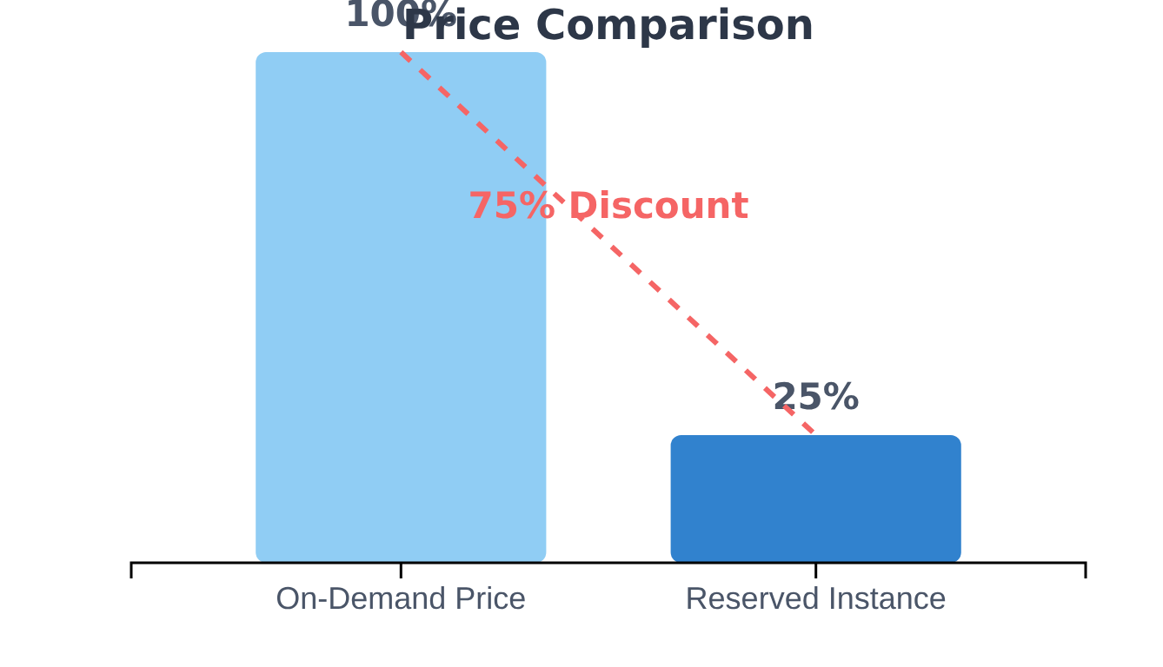








Answer 11: Reserved Instances
Correct Answer: B. Reserved Instances
Key Points:
Up to 75% discount compared to On-Demand prices
Requires 1-year or 3-year term commitment
Ideal for applications with predictable, continuous workloads
Best for steady-state applications where capacity is known in advance
Did you know?
Reserved Instances can be purchased with or without upfront payments, offering flexibility based on your financial preferences.

Slide 25
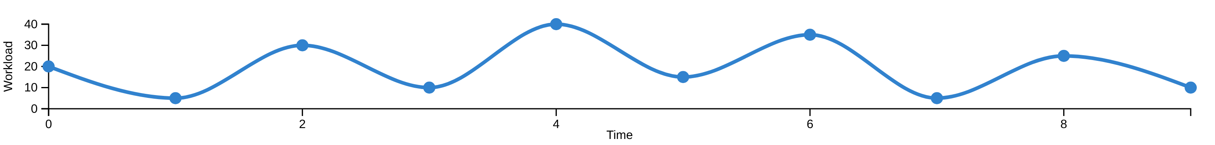


Question 12: On-Demand Pricing
Which EC2 purchasing option is best for short-term, spiky workloads?
A
Reserved Instances
B
Spot Instances
C
On-Demand Instances
D
Dedicated Hosts

Slide 26








Answer 12: On-Demand Pricing
The correct answer is C. On-Demand Instances
Why On-Demand Instances?
On-Demand Instances offer the most flexibility for EC2 purchasing, allowing users to pay for compute capacity by the second (or hour for older instances) with no long-term commitments or upfront payments.
Pay by the Second
No Long-Term Commitments
Flexible pricing based on actual usage time, with billing accurate to the second.
No upfront payments or long-term contracts required, providing maximum flexibility.
Development & Testing
Unpredictable Workloads
Ideal for development, testing, and other workloads with irregular usage patterns.
Perfect for applications with irregular and unpredictable usage patterns.

Slide 27





Question 13: Savings Plans
Which pricing model provides discounts for consistent usage across compute services?
Savings Plans
Commit to consistent usage for significant discounts
A
Reserved Instances
B
Spot Instances
C
Dedicated Instances
D
Savings Plans

Slide 28









Answer 13: Savings Plans
Correct Answer: D. Savings Plans
Explanation:
Savings Plans offer lower prices compared to On-Demand, in exchange for a commitment to a consistent amount of compute usage (measured in $/hour) for a 1-year or 3-year term.
Lower Prices
Flexibility
Term Options
Significant cost savings compared to On-Demand pricing for consistent usage
Works across instance families, sizes, operating systems, and AWS Regions
1-year or 3-year commitment terms to match your business needs
Did you know?
Unlike Reserved Instances, Savings Plans provide flexibility across instance families, sizes, operating systems, and even AWS Regions, making them more adaptable to changing workloads.

Slide 29









Question 14: Dedicated Hosts
Which EC2 purchasing option is required for strict compliance requirements or software licensing models tied to physical servers?
A
Dedicated Instances
B
Spot Instances
C
Dedicated Hosts
D
Capacity Reservations

Slide 30






Answer 14: Dedicated Hosts
Correct Answer: C. Dedicated Hosts
Explanation:
Dedicated Hosts provide physical EC2 servers dedicated for your exclusive use. This option is particularly useful for addressing strict compliance requirements and for leveraging existing server-bound software licenses.
Physical Server Dedication
Compliance Requirements
Provides fully dedicated physical servers for your account, ensuring exclusive use of underlying hardware.
Helps address strict compliance requirements that mandate physical isolation of workloads.
Software Licensing
Visibility
Allows you to leverage existing server-bound software licenses, reducing software costs.
Provides visibility into the underlying physical server, allowing for detailed configuration management.

Slide 31
Stay Connected with Our Cloud Computing Journey!
Dive deeper into the cloud world! Check out our specialized playlists for your continuous learning journey!
Like this video if you found it helpful!
Subscribe for cloud tech updates!
Comment below which cloud topic you want to see next like:
Cloud Security Tips
Cost Optimization Strategies
Multi-Cloud Management
Serverless Computing
Cloud Migration Steps
Anything you'd like 🙂

Slide 32




AWS Support Plans
Comprehensive Guide to AWS Support Services

Slide 33











Introduction to AWS Support
AWS Support Plans assist customers in effectively utilizing AWS services by offering various levels of technical assistance and resources, ensuring optimal environment operation and troubleshooting.
Basic Support
Developer Support
Business Support
Enterprise On-Ramp
Enterprise Support
Account & billing support
Development & testing
Production workloads
Subset of Enterprise Support
Mission-critical applications
Response Time
Trusted Advisor
From 24x7x365 support for Enterprise to business hours only.
Access to checks ranging from 7 core checks in Basic to full set in Enterprise
Technical Account Manager
Pricing
Dedicated TAM available only with Business and Enterprise plans
Free for Basic plan; Developer starts at $29/month; Business at $100/month; Enterprise at $15,000/month

Slide 34












Basic Support Plan
Free
The AWS Basic Support Plan is the default offering for all AWS customers, provided at no additional cost. It's designed for users who primarily need assistance with account and billing inquiries and access to self-service resources.
Response Time
24x7 access to customer service, but support requests are handled during business hours
Support Access
Account and billing support only, no technical support for service issues
Key Benefits
24x7 access to customer service for account and billing issues
Access to comprehensive AWS documentation and whitepapers
Trusted Advisor
Access to 7 core Trusted Advisor checks focusing on service limits and basic security
Access to AWS Support forums and re:Post community
Service Health Dashboard and Personal Health Dashboard
Cost Optimization
No proactive cost optimization support included

Slide 35







Developer Support Plan
AWS Developer Support Plan offers entry-level paid support for early-stage development and testing on AWS, ideal for non-production or limited production use cases.
Pricing
$29
per month
Key Features
Or 3% of monthly AWS charges, whichever is higher
Unlimited Support Cases
Open unlimited cases with unlimited contacts (IAM supported)
Ideal For
Business Hours Access
Early-stage development
Email access to Cloud Support Associates during business hours
Experimentation on AWS
Non-production workloads
Best Practice Guidance
Limited production use cases
General best practice guidance and building-block architecture support
Trusted Advisor Access
Access to service quota and basic security checks

Slide 36













Business Support Plan
The AWS Business Support Plan is designed for production workloads that require 24/7 technical support with faster response times and comprehensive assistance.
Response Times
Production System Down
Less than 1 hour
24/7 Support
Unlimited Cases
Production System Impaired
Phone, chat, and web access to AWS Cloud Support Engineers
Unlimited cases with unlimited contacts (IAM supported)
Less than 4 hours
Full Trusted Advisor
Architectural Guidance
Pricing
Complete set of AWS Trusted Advisor best practice checks
Contextual architectural guidance related to your deployments
From $100/month
Tiered percentages of monthly AWS charges
AWS Support API
Third-Party Support
Access to the AWS Support API for programmatic case management
Support for third-party software, including OS and application stack
AWS Countdown Premium add-on available
AWS Support App in Slack access
Billing and account assistance

Slide 37











AWS Enterprise On-Ramp Support Plan
Key Features & Benefits
Plan Overview
Designed for customers with business-critical workloads on AWS.
Enhanced Technical Support
Technical Account Management
24/7 access to Senior Cloud Support Engineers via phone, chat, and web.
Access to Technical Account Managers for architectural guidance.
Key Benefits
Rapid response times
Expert cloud optimization
Billing & Account Management
AWS Trusted Advisor
Strategic bridge to Enterprise
Support Concierge service for billing and account inquiries.
Full set of Trusted Advisor checks for cost optimization and security.
Response Times
Pricing Model
Business-critical system down: < 30 minutes
Monthly fee: The greater of $5,500 or 10% of monthly AWS charges.
Production system down: < 1 hour

Slide 38












Enterprise Support Plan
$15,000/month
Premium support for large-scale enterprises running business or mission-critical applications, demanding rapid incident resolution and strategic cloud management.
Dedicated Technical Account Manager
AWS Managed Services
Personalized consultative guidance and long-term architectural advisory
Operational management and cloud operations outsourcing
Fastest SLAs
AWS Countdown
Less than 15 minutes for business/mission-critical system down issues
Free planning and risk mitigation for launch events and migrations
Strategic Business Reviews
re:Post Private
Regular reviews aligned with business objectives and cost-optimization
Internal knowledge sharing and collaboration platform
Proactive Monitoring
White-glove Support
24/7 proactive monitoring with 5-minute incident engagement response
Concierge-level billing and account support

Slide 39









AWS Support Plans Comparison
Feature
Basic
Developer
Business
Enterprise On-Ramp
Enterprise
Recommended Use Case
All customers
Experimenting & testing
Production workloads
Business-critical workloads
Business & mission-critical workloads
24/7 Technical Support
No
Business hours only
Yes (24/7)
Yes (24/7)
Yes (24/7)
Technical Support Access
Customer Service
Limited developers
Unlimited cases & contacts
Unlimited cases & contacts; TAM pool
Unlimited cases & contacts; designated TAM
Architectural Guidance
None
General guidance
Contextual to use case
Annual consultative reviews
Ongoing consultative reviews
AWS Trusted Advisor Checks
Core checks
Service quota & security
Full checks
Full checks
Full checks + prioritized recommendations
Proactive Programs
No
Support Automation
Support Automation
Support Automation + 1 free AWS Countdown engagement/year
Extensive proactive reviews + workshops
Response Time (business-critical down)
N/A
N/A
N/A
< 30 minutes
< 15 minutes

Slide 40






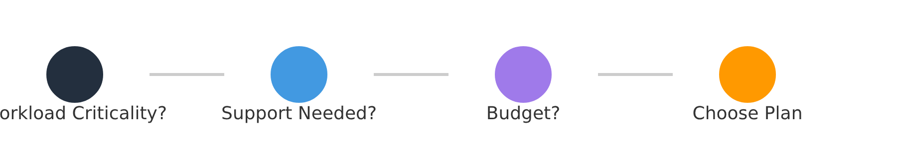
Choosing the Right Plan
Selecting the appropriate AWS Support Plan requires balancing your workload criticality, technical support needs, and budget.
Workload Criticality
Support Access
Budget
Non-production: Basic/Developer
Basic: 24x7 account support
Basic: Free
Production: Business/Enterprise
Developer: Business hrs email
Developer: $29+/month
Business/Enterprise: 24x7
Business: $100+/month
Basic Plan
Developer Plan
Business Plan
Enterprise Plan
For non-production, experimental workloads
For development, testing, non-prod use cases
For production workloads requiring 24/7 support
For mission-critical applications
W

Slide 41
Stay Connected with Our Cloud Computing Journey!
Dive deeper into the cloud world! Check out our specialized playlists for your continuous learning journey!
Like this video if you found it helpful!
Subscribe for cloud tech updates!
Comment below which cloud topic you want to see next like:
Cloud Security Tips
Cost Optimization Strategies
Multi-Cloud Management
Serverless Computing
Cloud Migration Steps
Anything you'd like 🙂

